Slide 1
Software architecture = {Elements, Forms, Rationale/Constraints)
SEN 3244
Software Architecture
M. Mangong Clement
Software architecture deals with the design of the high level structure of sw

Slide 2
Software architecture = {Elements, Forms, Rationale/Constraints)
Chap 8: Designing Software Architecture
Task - Class Work
“In groups of three students, download the ppt. notes, and answer
the questions of each of the slides”
You shall present your answers towards the end of class.
You can use your tools in case to demonstrate your work
Software architecture deals with the design of the high level structure of SWE

Slide 3
Software architecture = {Elements, Forms, Rationale/Constraints)
Chap 8: Designing Software Architecture
“A designer knows he has achieved perfection not when there is nothing left to add,
but when there is nothing left to take away.”
- Antoine de Saint-Exupery
Software architecture deals with the design of the high level structure of SWE

Slide 4
Software architecture = {Elements, Forms, Rationale/Constraints)
Chap 8: Designing Software Architecture
Architecture design overview
It involves making decisions, and working with the available materials and skills, to achieve a goals and to satisfy requirements and constraints.
The output(final decisions) will reflect the goals, requirements and constraints.
Software architecture deals with the design of the high level structure of SWE
Notes:
Questions :
Give the example of making decisions in architectural design
Give an example of the available material you have to design an architecture
What are the skill you have inquired that helps you to design your architecture
Give two goals for you designing the architecture of the first assignment ( Moodle platform)
What are the requirements and the constraint you define so that you architecture can satisfy at the end?
Why is it said the output is the final decisions and not an initial idea?

Slide 5
Software architecture = {Elements, Forms, Rationale/Constraints)
Chap 8: Designing Software Architecture
Architecture design overview
We turn decisions about the architectural drivers / concerns into structures.
The structures are then used to :-
Guide the project ( analysis and construction)
Guide cost and schedule estimation, team formation , risk analysis and mitigation.
Software architecture deals with the design of the high level structure of SWE
Notes:
Question :
Give two architectural drivers of designing the Moodle platform architecture
Give two reasons that the architectural designed will explore to assist in the project
How do you have the initial cost of your project ?

Slide 6
Software architecture = {Elements, Forms, Rationale/Constraints)
Chap 8: Designing Software Architecture
Architecture design overview
It serves as the foundation for educating a new project member.
It guides the cost and schedule estimations, team formation, risk analysis and mitigation , and implementation.
Software architecture deals with the design of the high level structure of SWE
Notes:
what design is vital for a team new member to understand before getting into detailed design?

Slide 7
Software architecture = {Elements, Forms, Rationale/Constraints)
Chap 8: Designing Software Architecture
Architecture design overview
The good news to software architect is that, there are proven designs and design fragments, or building blocks that we call design concepts , that can be reused and combined to reliably achieve these goals.
Software architecture deals with the design of the high level structure of SWE
Notes:
Question
Give examples of design concepts as mentioned above that will help you to architect the project

Slide 8
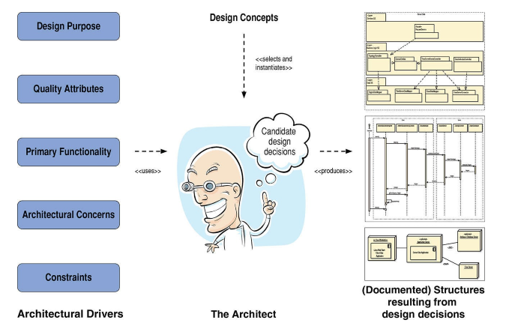
Software architecture = {Elements, Forms, Rationale/Constraints)
Chap 8: Designing Software Architecture
Overview of the architecture design activity(1)
Software architecture deals with the design of the high level structure of SWE
Notes:
Explain design purpose and how to express it
What is the attribution of quality attributes to architect’s work
What is the difference between primary functionality and normal functionality and why consider it during architectural design?
Give four architectural concerns with respect to the Moodle platform architecture
What are constraints and why do we need to consider it in our design
What are design concepts and how helpful is it to our design?

Slide 9
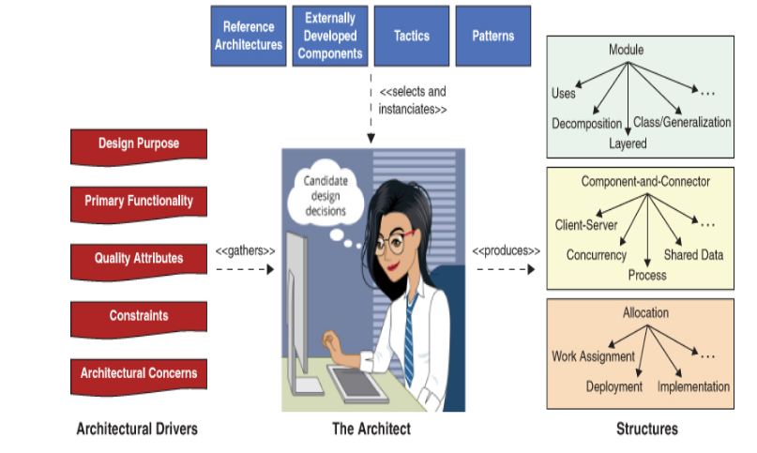
Software architecture = {Elements, Forms, Rationale/Constraints)
Chap 8: Designing Software Architecture
Overview of the architecture design activity(2)
Software architecture deals with the design of the high level structure of SWE

Slide 10
Software architecture = {Elements, Forms, Rationale/Constraints)
Chap 8: Designing Software Architecture
Overview of the architecture design activity
Architectural decisions do occur at three levels of design.
Architectural design – level one
Element interaction design – level two
Element internals design – level three
However, level one can delve as deeply as elements internals design to achieve a particular driver.
Software architecture deals with the design of the high level structure of SWE
Notes:
Questions
Why not use high level design and low level design , we prefer to use these there levels of design
When can each level be used?

Slide 11
Software architecture = {Elements, Forms, Rationale/Constraints)
Chap 8: Designing Software Architecture
Overview of the architecture design activity
Architectural decisions do occur at three levels of design(1).
One can not design an element’s internals until the element themselves have been defined
One cannot reason about interaction until several elements and some patterns of interaction among them have been defined.
Software architecture deals with the design of the high level structure of SWE
Notes:
Quesition
Give the justification for the two words of this slide

Slide 12
Software architecture = {Elements, Forms, Rationale/Constraints)
Chap 8: Designing Software Architecture
Overview of the architecture design activity
Architectural decisions do occur at three levels of design(2).
Some will use the term - high level design and detailed design/ low level design.
we prefer architectural design , element interaction design and element internals design
Software architecture deals with the design of the high level structure of SWE

Slide 13
Software architecture = {Elements, Forms, Rationale/Constraints)
Chap 8: Designing Software Architecture
Overview of the architecture design activity
Architectural design is therefore a key step to achieving your product and project goals.
The decision you take will have an implications for the achievement of these goals.
The choice of a particular reference architecture may provide a good foundation for achieving your goal because of their familiarities.
Software architecture deals with the design of the high level structure of SWE
Notes:
Question
1. Why the architecture design is the key step than the normal design with respect to this contest

Slide 14
Software architecture = {Elements, Forms, Rationale/Constraints)
Chap 8: Designing Software Architecture
Overview of the architecture design activity
All architectures are design, but not all designs are architectures
What makes a decision architectural?
If the decision taken has consequences and those consequences matter to the achievement of an architectural driver( does it have consequence on performance, availability, modifiability…).
No decision is inherently architectural or non- architectural.
Software architecture deals with the design of the high level structure of SWE
Notes:
Question
Give a justification for the statement
All architecture is design, but not all design is architecture
What decision in the software is not an architectural decision? Justify your response

Slide 15
Software architecture = {Elements, Forms, Rationale/Constraints)
Chap 8: Designing Software Architecture
Overview of the architecture design activity
Element Interaction Design – 2nd level of design
Architectural design identifies only a subset of elements that are part of the system’s structure.
Architect focus on the primary functionality of the system
Primary use cases give the primary functionality
The elements that support the non primary use case and their interfaces are part of the element interaction design
Software architecture deals with the design of the high level structure of SWE
Notes:
Explain level one , two and three of software architectural design

Slide 16
Software architecture = {Elements, Forms, Rationale/Constraints)
Chap 8: Designing Software Architecture
Overview of the architecture design activity
Element Interaction Design – 2nd level of design(1)
The location and relationships of these elements are constrained by the decisions that were made during architectural design
The elements can be unit of work called modules assigned to an individual or to a team.
Software architecture deals with the design of the high level structure of SWE

Slide 17
Software architecture = {Elements, Forms, Rationale/Constraints)
Chap 8: Designing Software Architecture
Overview of the architecture design activity
Element Internals Design – 3rd level of design
Conducted as part of the element development activities
The internals of the elements in the previous design level are established so as to satisfy the element’s interface.
Also called detailed design as the design is designing the internals of modules
Software architecture deals with the design of the high level structure of SWE

Slide 18
Software architecture = {Elements, Forms, Rationale/Constraints)
Chap 8: Designing Software Architecture
Overview of the architecture design activity
Architectural Drivers
We categorize “what” and “why” questions as architectural drivers.
The Architectural drivers used
Design purpose, quality attributes, primary functionality , architectural concerns, and constraints.
The consideration drives and shapes architecture’s success.
Software architecture deals with the design of the high level structure of SWE
Notes:
What are architectural derivers?

Slide 19
Software architecture = {Elements, Forms, Rationale/Constraints)
Chap 8: Designing Software Architecture
Overview of the architecture design activity
Architectural Drivers – Design Purpose
You need a clear purpose of the design
When and why are you doing this architecture design?
Which business goals is the organization most concerned about at this time?
Software architecture deals with the design of the high level structure of SWE
Notes:
Use this two points to bring out the goals of the assignment of architecting the Moodle platform

Slide 20
Software architecture = {Elements, Forms, Rationale/Constraints)
Chap 8: Designing Software Architecture
Overview of the architecture design activity
Architectural Drivers – Design Purpose(1)
You may be doing architecture design as part of the project proposals.
For pre-sales process in a consulting organization
For internal project selection and prioritization in a company.
Such will not be detailed it purpose is to understand and break down the architecture in sufficient details that the unites of work are understood and hence may be estimated.
Software architecture deals with the design of the high level structure of SWE

Slide 21
Software architecture = {Elements, Forms, Rationale/Constraints)
Chap 8: Designing Software Architecture
Overview of the architecture design activity
Architectural Drivers – Design Purpose(2)
2. Doing architecture design as part of the process of creating an exploratory prototype.
Incase the purpose is not so much to create a releasable or reusable system, but rather to explore the domain, to explore new technology, to place something executable in front of a customer to elicit rapid feedback, or to explore a quality attribute.
Software architecture deals with the design of the high level structure of SWE

Slide 22
Software architecture = {Elements, Forms, Rationale/Constraints)
Chap 8: Designing Software Architecture
Overview of the architecture design activity
Architectural Drivers – Design Purpose(3)
3. You may be designing your architecture during development
This could be for an entire new system, a portion of a new system, or existing system that is being refactored or replaced.
In this case, the purpose is to do enough design work to satisfy requirements, guide system construction and work assignments, and prepare for an eventual release.
Software architecture deals with the design of the high level structure of SWE

Slide 23
Software architecture = {Elements, Forms, Rationale/Constraints)
Chap 8: Designing Software Architecture
Overview of the architecture design activity
Architectural Drivers – Design Purpose(4)
It will after the design process and the outputs of the design so the architect should be clear about these goals and should communicate them and establish a clear design purpose before beginning the design process.
Software architecture deals with the design of the high level structure of SWE

Slide 24
Software architecture = {Elements, Forms, Rationale/Constraints)
Chap 8: Designing Software Architecture
Overview of the architecture design activity
Architectural Drivers – Quality Attributes(1)
These are measurable or testable properties of a system that are used to indicate how well the system satisfies the needs of its stakeholders.
They are quality attributes that shape the architecture most significantly.
Software architecture deals with the design of the high level structure of SWE

Slide 25
Software architecture = {Elements, Forms, Rationale/Constraints)
Chap 8: Designing Software Architecture
Overview of the architecture design activity
Architectural Drivers – Quality Attributes(2)
You must worry about eliciting, specifying, prioritizing and validating the quality attributes.
Software architecture deals with the design of the high level structure of SWE
Notes:
How do you elicit , specify and prioritize and validate the quality attributes of the architectural design of the Moodle platform

Slide 26
Software architecture = {Elements, Forms, Rationale/Constraints)
Chap 8: Designing Software Architecture
Overview of the architecture design activity
Architectural Drivers – Quality Attributes(3)
Widely use technique that help here
QAW ( Quality Attribute Workshop)
Facilitated brainstorming session involving a group of system stakeholders that covers the bulk of activities of eliciting, specifying, prioritizing and achieving consensus on quality attributes.
Software architecture deals with the design of the high level structure of SWE

Slide 27
Software architecture = {Elements, Forms, Rationale/Constraints)
Chap 8: Designing Software Architecture
Overview of the architecture design activity
Architectural Drivers – Quality Attributes(3)
Widely use technique that help here(1)
Mission Thread workshop
Serve the same purpose as QAW , but for a system of systems
The Utility Tree can be used by the architect to prioritize quality attribute requirement according to their technical difficulty and risk
Software architecture deals with the design of the high level structure of SWE

Slide 28
Software architecture = {Elements, Forms, Rationale/Constraints)
Chap 8: Designing Software Architecture
Overview of the architecture design activity
Architectural Drivers – Quality Attributes(3)
Widely use technique that help here(2)
The use of scenario or set of scenarios is one of the best ways to discuss, document, and prioritize quality attribute requirements.
A scenario describes the system’s response to some stimulus.
Software architecture deals with the design of the high level structure of SWE

Slide 29
Software architecture = {Elements, Forms, Rationale/Constraints)
Chap 8: Designing Software Architecture
Overview of the architecture design activity
Architectural Drivers – Quality Attributes(3)
Quality attribute scenario
Pairing of a stimulus with a response
Example : suppose you are building a video game
“This game shall change view modes when the user presses the <C> button”
The functional requirement, if its important needs to be associated with quality attributes requirements
Software architecture deals with the design of the high level structure of SWE

Slide 30
Software architecture = {Elements, Forms, Rationale/Constraints)
Chap 8: Designing Software Architecture
Overview of the architecture design activity
Architectural Drivers – Quality Attributes(3)
Quality attribute scenario(1)
Example : suppose you are building a video game
How fast should the function be?
How secure should the function be?
How modifiable should the function be?
To address this problem, we use a scenario to describe a quality attribute requirement.
Software architecture deals with the design of the high level structure of SWE

Slide 31
Software architecture = {Elements, Forms, Rationale/Constraints)
Chap 8: Designing Software Architecture
Overview of the architecture design activity
Architectural Drivers – Quality Attributes(3)
Quality attribute scenario(2)
It’s a short description of how a system is required to respond to some stimulus.
It adds the source of stimulus, the artifact affected is the entire system, and the environment.
Software architecture deals with the design of the high level structure of SWE

Slide 32
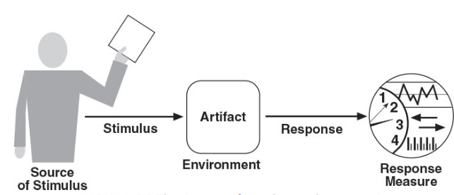
Software architecture = {Elements, Forms, Rationale/Constraints)
Chap 8: Designing Software Architecture
Overview of the architecture design activity
Architectural Drivers – Quality Attributes(3)
Quality attribute scenario(3)
The six parts of a quality attribute scenario
Software architecture deals with the design of the high level structure of SWE

Slide 33
Software architecture = {Elements, Forms, Rationale/Constraints)
Chap 8: Designing Software Architecture
Overview of the architecture design activity
Architectural Drivers – Quality Attributes(3)
Quality attribute scenario(4) - Prioritization
Consider two dimensions that are associated with each scenario and that assigned a rank of importance.
1st Dimension : Corresponds to the importance of the scenario with respect to the success of the system. This is ranked by the customer.
2nd Dimension : Corresponds to the degree of technical risk associated with the scenario. This is ranked by the architect.
Software architecture deals with the design of the high level structure of SWE

Slide 34
Software architecture = {Elements, Forms, Rationale/Constraints)
Chap 8: Designing Software Architecture
Overview of the architecture design activity
Architectural Drivers – Quality Attributes(3)
Quality attribute scenario(4) – Prioritization(1)
A low/medium/high (L/M/H) scale is used to rank both dimensions.
Once it has been ranked, scenario are prioritized by selecting that have a consideration of (H,H), (H,M), or (M,H) rankings.
Software architecture deals with the design of the high level structure of SWE

Slide 35
Software architecture = {Elements, Forms, Rationale/Constraints)
Chap 8: Designing Software Architecture
Overview of the architecture design activity
Architectural Drivers – Quality Attributes(4)
You can always elicit at lease a range of possible responses
Instead of saying the system should be “fast” ask the stakeholder
if a 10-second response time is acceptable
if that is unacceptable, ask if 5 seconds is ok, or 1 second and you will find out that the users knows more than they realize.
Software architecture deals with the design of the high level structure of SWE

Slide 36
Software architecture = {Elements, Forms, Rationale/Constraints)
Chap 8: Designing Software Architecture
Overview of the architecture design activity
Architectural Drivers – Quality Attributes(5)
Assignment –
Research on Quality attribute workshop and the Utility Tree
What are the steps in QAW?
Software architecture deals with the design of the high level structure of SWE

Slide 37
Software architecture = {Elements, Forms, Rationale/Constraints)
Chap 8: Designing Software Architecture
Overview of the architecture design activity
Architectural Drivers – Quality Attributes(6)
Quality attribute workshop and the Utility Tree
The steps of the QAW
QAW Presentation and introductions
Business goals Presentation
Architectural plan presentation
Identification of drivers
Scenario Brainstorming
Scenario consolidation
Scenario prioritization
Scenario refinement
Software architecture deals with the design of the high level structure of SWE
Notes:
In groups of 3’s members, Carry out a QAW and present the Utility tree of the Moodle system

Slide 38
Software architecture = {Elements, Forms, Rationale/Constraints)
Chap 8: Designing Software Architecture
Overview of the architecture design activity
Architectural Drivers – Quality Attributes(7)
Class work assignment
In groups of 3’s members, Carry out a QAW and present the Utility tree of the Moodle system
Software architecture deals with the design of the high level structure of SWE

Slide 39
Software architecture = {Elements, Forms, Rationale/Constraints)
Chap 8: Designing Software Architecture
Overview of the architecture design activity
Architectural Drivers – Primary Functionality
Functionality is the ability of the system to do the work for which it was intended.
The way the system is structured does not affect the functionality.
You can have all the functionality of a system coded in one module.
Software architecture deals with the design of the high level structure of SWE

Slide 40
Software architecture = {Elements, Forms, Rationale/Constraints)
Chap 8: Designing Software Architecture
Overview of the architecture design activity
Architectural Drivers – Primary Functionality(1)
In terms of architectural design, allocation of functionality to elements is what matters.
A good architecture is one in which the most common changes are localized in a single or a few elements, and hence easy to make.
Software architecture deals with the design of the high level structure of SWE

Slide 41
Software architecture = {Elements, Forms, Rationale/Constraints)
Chap 8: Designing Software Architecture
Overview of the architecture design activity
Architectural Drivers – Primary Functionality(2)
Consider primary functionality when designing an architecture.
Primary functionality is functionality that is critical to achieve the business goals that motivate the development of the system.
Software architecture deals with the design of the high level structure of SWE

Slide 42
Software architecture = {Elements, Forms, Rationale/Constraints)
Chap 8: Designing Software Architecture
Overview of the architecture design activity
Architectural Drivers – Primary Functionality(3)
You need to think how functionality will be allocated to elements (usually modules) to promote modifiability or reusability
Some quality attribute scenarios are directly connected to the primary functionality.
Software architecture deals with the design of the high level structure of SWE

Slide 43
Software architecture = {Elements, Forms, Rationale/Constraints)
Chap 8: Designing Software Architecture
Overview of the architecture design activity
Architectural Drivers – Primary Functionality(4)
Refactoring
If you refactor a software architecture , what you are doing is maintaining the same functionality but changing some quality attributes that you care about,
Software architecture deals with the design of the high level structure of SWE

Slide 44
Software architecture = {Elements, Forms, Rationale/Constraints)
Chap 8: Designing Software Architecture
Overview of the architecture design activity
Architectural Drivers – Architectural concerns
Additional aspects you need to consider as part of the architectural design.
Software architecture deals with the design of the high level structure of SWE

Slide 45
Software architecture = {Elements, Forms, Rationale/Constraints)
Chap 8: Designing Software Architecture
Overview of the architecture design activity
Architectural Drivers – Architectural concerns-1
There are several concerns
General concerns – broad issues with creating the architecture, such as establishing an overall system structure, the allocation of functionality to modules, the allocation of modules to teams, organization of the code base, startup and shutdown, and supporting delivery, deployment and updates.
Software architecture deals with the design of the high level structure of SWE

Slide 46
Software architecture = {Elements, Forms, Rationale/Constraints)
Chap 8: Designing Software Architecture
Overview of the architecture design activity
Architectural Drivers – Architectural concerns-2
There are several concerns
Specific concerns – detailed system –internal issues such as exception management, dependency management , configuration, logging, authentication, authorization, cashing ,,,
Software architecture deals with the design of the high level structure of SWE

Slide 47
Software architecture = {Elements, Forms, Rationale/Constraints)
Chap 8: Designing Software Architecture
Overview of the architecture design activity
Architectural Drivers – Architectural concerns-3
There are several concerns
Internal requirements – May address aspects that facilitate development, deployment, operation, or maintenance of the system.
Issues – Result from analysis activities, such as design review
Software architecture deals with the design of the high level structure of SWE

Slide 48
Software architecture = {Elements, Forms, Rationale/Constraints)
Chap 8: Designing Software Architecture
Overview of the architecture design activity
Architectural Drivers – constraints
Write out the constraints ; it will be use as part of the architectural design process.
It may be a technical constraint or non technical
A decision over which you have tittle or no control as an architect.
Software architecture deals with the design of the high level structure of SWE

Slide 49
Software architecture = {Elements, Forms, Rationale/Constraints)
Chap 8: Designing Software Architecture
Overview of the architecture design activity
Architectural Drivers – constraints(1)
It may be a form of mandated technologies, system you need to integrate, laws and standards that must be compiled with, the abilities and availability of your developers, deadlines that are non-negotiable, backward combability with order versions of system..
Software architecture deals with the design of the high level structure of SWE

Slide 50
Software architecture = {Elements, Forms, Rationale/Constraints)
Chap 8: Designing Software Architecture
Overview of the architecture design activity
Architectural Drivers – constraints(2)
Example –
Technical constraints is the use of open source technologies,
Whereas a nontechnical constraint is that the system must be delivered by December 15.
Software architecture deals with the design of the high level structure of SWE

Slide 51
Software architecture = {Elements, Forms, Rationale/Constraints)
Chap 8: Designing Software Architecture
Overview of the architecture design activity
Design Concepts : - building blocks for creating structures
Design is not random but planned, intentional , rational and directed.
Different types of design concepts exist
Reference architecture, deployment patterns, architectural patterns , tactics and externally developed components.
Software architecture deals with the design of the high level structure of SWE

Slide 52
Software architecture = {Elements, Forms, Rationale/Constraints)
Chap 8: Designing Software Architecture
Overview of the architecture design activity
Design Concepts : - Reference Architectures
Blueprints that provide an overall logical structure for particular types of applications.
It’s a reference model mapped onto one or more architectural patterns.
Software architecture deals with the design of the high level structure of SWE

Slide 53
Software architecture = {Elements, Forms, Rationale/Constraints)
Chap 8: Designing Software Architecture
Overview of the architecture design activity
Design Concepts : - Reference Architectures(1)
Example
Reference architecture for the development of web application is showed on the next slide.
Software architecture deals with the design of the high level structure of SWE

Slide 54
Software architecture = {Elements, Forms, Rationale/Constraints)
Chap 8: Designing Software Architecture
Overview of the architecture design activity
Design Concepts : - Reference Architectures(2)
Example
Software architecture deals with the design of the high level structure of SWE

Slide 55
Software architecture = {Elements, Forms, Rationale/Constraints)
Chap 8: Designing Software Architecture
Overview of the architecture design activity
Design Concepts : - Reference Architectures(3)
Reference architecture may be confused with architectural style.
Architectural style (such as pipe and filters) define types of components and connectors in a specific topology that are useful for structuring an application either logically or physically.
Software architecture deals with the design of the high level structure of SWE

Slide 56
Software architecture = {Elements, Forms, Rationale/Constraints)
Chap 8: Designing Software Architecture
Overview of the architecture design activity
Design Concepts : - Reference Architectures(4)
Reference architecture provide a structure for application in a specific domains, and they may embody different styles.
While architectural styles tend to be popular in academia, reference architectures seems to be preferred by practitioners.
Software architecture deals with the design of the high level structure of SWE

Slide 57
Software architecture = {Elements, Forms, Rationale/Constraints)
Chap 8: Designing Software Architecture
Overview of the architecture design activity
Design Concepts :Architectural design Patterns
Its solutions to recurring design problems that exist in a defined context.
For example architectural pattern that is useful for structuring the system, the layer pattern.
When you choose a pattern such as this one, you must decide how many layers you will need for your system.
Software architecture deals with the design of the high level structure of SWE

Slide 58
Software architecture = {Elements, Forms, Rationale/Constraints)
Chap 8: Designing Software Architecture
Overview of the architecture design activity
Design Concepts :Architectural design Patterns
Example:
Software architecture deals with the design of the high level structure of SWE

Slide 59
Software architecture = {Elements, Forms, Rationale/Constraints)
Chap 8: Designing Software Architecture
Overview of the architecture design activity
Design Concepts :Deployment Patterns
It provide models on how to physically structure the system to deploy it.
Software architecture deals with the design of the high level structure of SWE

Slide 60
Software architecture = {Elements, Forms, Rationale/Constraints)
Chap 8: Designing Software Architecture
Overview of the architecture design activity
Design Concepts :Tactics
When architects use collections of fundamental design techniques to achieve a response for particular quality attributes, we call the architectural design primitive tactics.
Techniques that architects have been using for years.
Tactics is not invented but capture what architect have actually have done in practice.
Software architecture deals with the design of the high level structure of SWE

Slide 61
Software architecture = {Elements, Forms, Rationale/Constraints)
Chap 8: Designing Software Architecture
Overview of the architecture design activity
Design Concepts :Externally Developed components
Pattern and tactics are abstract in nature and when designing the architecture you need to make the concepts concrete and closer to actual implementation. We have two ways
Software architecture deals with the design of the high level structure of SWE

Slide 62
Software architecture = {Elements, Forms, Rationale/Constraints)
Chap 8: Designing Software Architecture
Overview of the architecture design activity
Design Concepts :Externally Developed components(1)
We have two ways ( Buy or Build)
Code the elements obtained from tactics and patterns.
Associate technologies with one or more of those elements in the architecture.
Software architecture deals with the design of the high level structure of SWE

Slide 63
Software architecture = {Elements, Forms, Rationale/Constraints)
Chap 8: Designing Software Architecture
Overview of the architecture design activity
Design Concepts :Externally Developed components(2)
Not created as part of the development project
Technology families ; RDBMS , ORM
Products; self-contained functional piece of software - Oracle or MS SQL Server
Application frameworks ;
Platforms ; Java, .Net or Google Cloud
Software architecture deals with the design of the high level structure of SWE

Slide 64
Software architecture = {Elements, Forms, Rationale/Constraints)
Chap 8: Designing Software Architecture
Overview of the architecture design activity
Design Concepts :Externally Developed components(3)
Criteria of selection
Problem that it addresses : Is it something specific, such as a framework for OO,
Cost : what is the cost of the license and if its free, what is the cost of support and education.
Software architecture deals with the design of the high level structure of SWE

Slide 65
Software architecture = {Elements, Forms, Rationale/Constraints)
Chap 8: Designing Software Architecture
Overview of the architecture design activity
Design Concepts :Externally Developed components(4)
Criteria of selection
Type of license : Does it have a license compatible with the project
Support
Learning curve
Software architecture deals with the design of the high level structure of SWE

Slide 66
Software architecture = {Elements, Forms, Rationale/Constraints)
Chap 8: Designing Software Architecture
Overview of the architecture design activity
Design Concepts :Externally Developed components(5)
Criteria of selection
Popularity
Compatibility and ease of integration
Support for critical quality attributes
Size
Software architecture deals with the design of the high level structure of SWE

Slide 67
Software architecture = {Elements, Forms, Rationale/Constraints)
Chap 8: Designing Software Architecture
Overview of the architecture design activity
Architectural design decision
Design is a process of making decisions
The act of act of making decisions is a process, not a moment of time
Software architecture deals with the design of the high level structure of SWE

Slide 68
Software architecture = {Elements, Forms, Rationale/Constraints)
Chap 8: Designing Software Architecture
Overview of the architecture design activity
The Architecture Design Process
The need for a principle method
The question is , how do you actual perform design?
Performing design to ensure that the drivers are satisfied requires a principled method
Software architecture deals with the design of the high level structure of SWE

Slide 69
Software architecture = {Elements, Forms, Rationale/Constraints)
Chap 8: Designing Software Architecture
Overview of the architecture design activity
“First things first”
Determine the scope of the system
– What is inside and what is outside of the system you are creating,
- And which external entities the system will interact with.
Software architecture deals with the design of the high level structure of SWE

Slide 70
Software architecture = {Elements, Forms, Rationale/Constraints)
Chap 8: Designing Software Architecture
Overview of the architecture design activity
“First things first”
Determine the scope of the system ( context)
– What is inside and what is outside of the system you are creating,
- And which external entities the system will interact with
Software architecture deals with the design of the high level structure of SWE

Slide 71
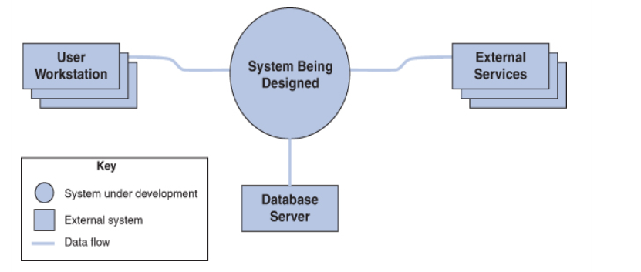
Software architecture = {Elements, Forms, Rationale/Constraints)
Chap 8: Designing Software Architecture
Overview of the architecture design activity
“First things first”(1)
The context can be represented by a context diagram: Example of a system context diagram
Software architecture deals with the design of the high level structure of SWE

Slide 72
Software architecture = {Elements, Forms, Rationale/Constraints)
Chap 8: Designing Software Architecture
Attribute-Driven Design(ADD)
ADD allows an architecture to be designed in a systematic , repeatable, and cost-effective way.
With ADD, architecture design is performed in rounds, each of which may consist of series of design iterations.
Software architecture deals with the design of the high level structure of SWE

Slide 73
Software architecture = {Elements, Forms, Rationale/Constraints)
Chap 8: Designing Software Architecture
Attribute-Driven Design(ADD)
A round comprises the architecture design activities performed within a development cycle.
Through one or more iteration, you produce an architecture that suits the established design purpose for this round.
Within each iteration, a set of design steps is performed.
Software architecture deals with the design of the high level structure of SWE

Slide 74
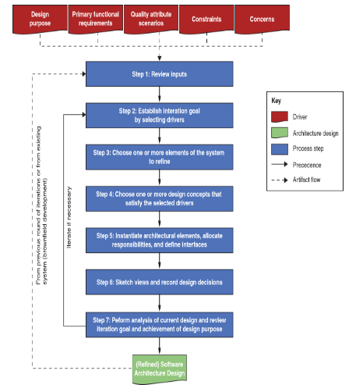
Software architecture = {Elements, Forms, Rationale/Constraints)
Chap 8: Designing Software Architecture
Attribute-Driven Design(ADD)
Software architecture deals with the design of the high level structure of SWE

Slide 75
Software architecture = {Elements, Forms, Rationale/Constraints)
Chap 8: Designing Software Architecture
Attribute-Driven Design(ADD)
Review inputs
Establish interaction goal by selecting drivers
Choose one or more elements of the system to refine
Choose one or more design concepts that satisfy the selected drivers
Instantiate architectural elements, allocate responsibilities, and define interfaces
Sketch views and record design discipline
Perform analysis of current design and review iteration goals and achievement of design purpose.
Software architecture deals with the design of the high level structure of SWE

Slide 76
Software architecture = {Elements, Forms, Rationale/Constraints)
Chap 8: Designing Software Architecture
Attribute-Driven Design(ADD)
Step 1: Review inputs
Before starting a design round,
You need to ensure that the architectural drivers ( the inputs to the design process) are available and correct.
Software architecture deals with the design of the high level structure of SWE

Slide 77
Software architecture = {Elements, Forms, Rationale/Constraints)
Chap 8: Designing Software Architecture
Attribute-Driven Design(ADD)
Step 1: Review inputs
Why capture the design purpose?
Why capture primary functional requirements?
Why primary quality attribute (QA) scenario?
Any constraints
Any concerns
Software architecture deals with the design of the high level structure of SWE
Notes:
Why the purpose
The QA scenarios should have been prioritized , ideally by your most important project stakeholders – use can use several techniques to elicit and prioritize stakeholders

Slide 78
Software architecture = {Elements, Forms, Rationale/Constraints)
Chap 8: Designing Software Architecture
Attribute-Driven Design(ADD)
Step 2: Establish iteration goal by selecting drivers
Each design iteration focuses on achieving a particular goal
Goal involves designing to satisfy a subset of the drivers.
You need to establish a goal before you start a particular design iteration.
Software architecture deals with the design of the high level structure of SWE

Slide 79
Software architecture = {Elements, Forms, Rationale/Constraints)
Chap 8: Designing Software Architecture
Attribute-Driven Design(ADD)
Step 3: Choose one or more elements of the system to refine
Satisfying drivers requires you to make architectural design decisions manifesting themselves in one or more architectural structures.
This structures are composed of interrelated elements-modules and/or components .
Software architecture deals with the design of the high level structure of SWE

Slide 80
Software architecture = {Elements, Forms, Rationale/Constraints)
Chap 8: Designing Software Architecture
Attribute-Driven Design(ADD)
Step 4: Choose one or more design concepts that satisfy the selected drivers
Choose the design concept(s) of the type of design concepts available – for example , tactics, patterns , reference architectures, and externally developed components
Software architecture deals with the design of the high level structure of SWE

Slide 81
Software architecture = {Elements, Forms, Rationale/Constraints)
Chap 8: Designing Software Architecture
Attribute-Driven Design(ADD)
Step 5: instantiate architectural elements, allocate responsibilities, and define interfaces.
You have to make another type of design decision : how to instantiate elements out of the design concepts that you just selected.
Software architecture deals with the design of the high level structure of SWE

Slide 82
Software architecture = {Elements, Forms, Rationale/Constraints)
Chap 8: Designing Software Architecture
Attribute-Driven Design(ADD)
Step 5: instantiate architectural elements, allocate responsibilities, and define interfaces(1).
Example if you selected the layers pattern, as a design concept, you must decide how many layers will be used, and their allowed relationships, since the pattern itself does not prescribe these.
Software architecture deals with the design of the high level structure of SWE

Slide 83
Software architecture = {Elements, Forms, Rationale/Constraints)
Chap 8: Designing Software Architecture
Attribute-Driven Design(ADD)
Step 5: instantiate architectural elements, allocate responsibilities, and define interfaces(2).
After instantiating the elements, you then need to allocate responsibilities to each of them
Example : in an app, at least three layers are usually present: presentation, business and data layers.
Software architecture deals with the design of the high level structure of SWE

Slide 84
Software architecture = {Elements, Forms, Rationale/Constraints)
Chap 8: Designing Software Architecture
Attribute-Driven Design(ADD)
Step 6: Sketch views and record design decision
Ensure that the views are preserved
Software architecture deals with the design of the high level structure of SWE

Slide 85
Software architecture = {Elements, Forms, Rationale/Constraints)
Chap 8: Designing Software Architecture
Attribute-Driven Design(ADD)
Step 7: Perform analysis of current design and review iteration goal and achievement of design purpose.
You can perform the analysis by reviewing the sketches of the views and design decisions that you captured.
Software architecture deals with the design of the high level structure of SWE

Slide 86


Software architecture = {Elements, Forms, Rationale/Constraints)
Welcome!
This course is design for you to understand the ways software architectures are represented, both in UML and other visual tools.
QUESTIONS
Software architecture deals with the design of the high level structure of SWE

